Slide 1
Twitter Identification of spam accounts

Slide 2
Group members:
Erik Hencier
Logan Margulis
Jennifer Shriver
Mentor:
Hani Dawoud

Slide 3
Main Goal
Detecting spam accounts on Twitter

Slide 4
Motivation-Why do we care?
Overload and backup can occur on the system due to mass spam behaviors
Disruptions will affect all users negatively
Malware and phishing sites posted by spam accounts can cause harm to individual user computer/device as well as their contacts

Slide 5
Methodology

Slide 6
What is a Twitter spam account?
“Spammers” are characterized as account holders who violate behavioral rules of Twitter
For example:
Posting harmful sites and links such as malware and phishing sites
Aggressive following tactics including mass following and unfollowing
Repeatedly posting multiple tweets
Including multiple “mentions” of other users in your tweets

Slide 7
Spammers vs. Parody Accounts
Spam
Parody
Intention is to cause malicious action and behavior on Twitter
Cause overflow and backup of the system due to mass retweeting, mass following and unfollowing
Intent is for comical purposes only and not to intentionally cause malicious harm to other users of Twitter
Created for entertainment purposes only

Slide 8
Methodology-Phase 1
First we read several articles to determine characteristics of spam accounts
We came up with 3 characteristics of what we thought determined a spam account
The number of tweets per day
The number of mentions in each tweet
ex.) Mentioning 20 other accounts in a tweets
The number of url links in each tweet
ex.) Posting several links that go to malware or phishing sites

Slide 9
We collected 3-4 potential spam accounts and 5-10 real accounts to compare the characteristics
It is a bit more complicated to find spam accounts than it used to be. Not all spam accounts have pictures of scantily clad women as the profile picture. Most actually have a normal profile picture, as well as a normal bio and they interact with other users like a real user would
Following are examples of spam accounts on Twitter and how they have characteristics of a real user

Slide 10
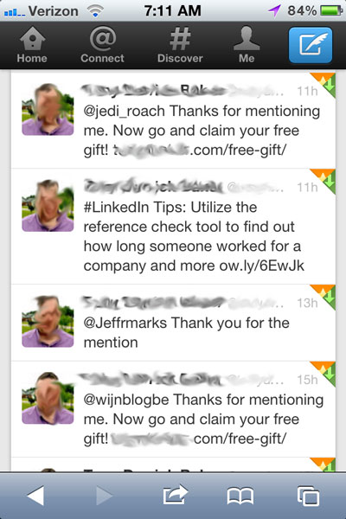

Slide 11
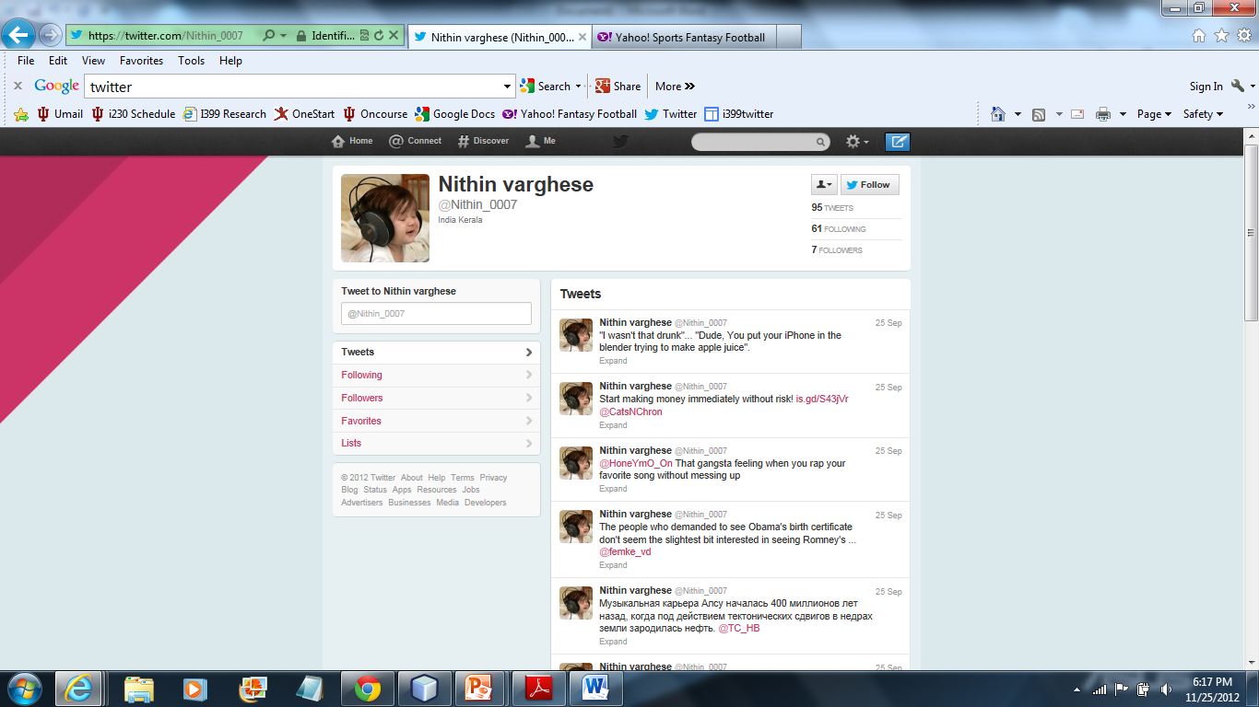

Slide 12
Methodology-Phase 2
We used Twitter API and NetBeans IDE to collect information on the accounts we collected
Hani wrote Java based web crawler programs through NetBeans that helped us gather information from each of the Twitter accounts

Slide 13
First we used the NetBeans program, FollowersGrabber, to identify the followers of our chosen accounts by account ID:
16916523
17557940
15831994
40020113
38055977
Current cursor is 0
Count 11086
BUILD SUCCESSFUL (total time: 7 seconds)

Slide 14
We then used Twitter API to pull the user timelines. This enables us to see how many times each user tweets and what is contained in the tweet.
[{"created_at":"Wed Sep 26 23:26:14 +0000 2012","id":251100395760414721,"id_str":"251100395760414721","text":"Hello FL. \ud83d\udc97 Nice to see you again!! http:\/\/t.co\/E0DUDTlB","source":"\u003ca href=\"http:\/\/instagr.am\" rel=\"nofollow\"\u003eInstagram\u003c\/a\u003e","truncated":false,"in_reply_to_status_id":null,"in_reply_to_status_id_str":null,"in_reply_to_user_id":null,"in_reply_to_user_id_str":null,"in_reply_to_screen_name":null,"user":{"id":26171592,"id_str":"26171592","name":"Kaylee Jesslyn","screen_name":"KayleeJesslyn","location":"Jacksonville, FL","url":"http:\/\/facebook.com","description":"Simplicity is beautiful.","protected":false,"followers_count":335,"friends_count":319,"listed_count":5,
Data contained in this specific tweet includes
Date & Time, ID/String, Text, Source, HREF, Location, Name, Protected Status, Followers count, and Friends count
We used a Json reader to convert this information into a format in which we can understand what the data is telling us

Slide 15
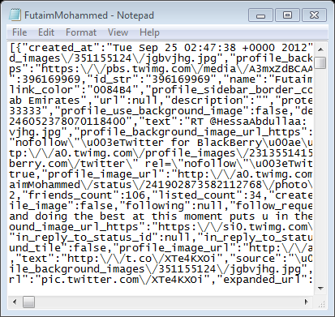
We used the TweetsCollector Java file to collect the most recent 200 tweets from each account
We ran this file every 2 days for 10 days to see if the accounts were actively tweeting and to collect enough data to determine if our chosen characteristics of a spam account are accurate
A text file was created from Java file and that is where the output results were sent

Slide 16
Finally we used the TweetsReader Java file to pull the specific number of mentions, links and tweets
This file counted all 3 of these characteristics for each time the account was ran through TweetsCollector
This is where we get our final data to compare
Example of TweetsReader data:

Slide 18
Using the data we collected from TweetsReader, we created graphs for each characteristic to help us compare the data more easily

Slide 19
Result Graphs

Slide 22
Results/Conclusions
What the graphs and the data show is that it is difficult to distinguish a spam account and a real account based only on these 3 characteristics
This could be because the accounts we thought were spam, were not actually spam
It could be because the business accounts we chose behaved more like stereotypical spam accounts
We most likely need to look at more than 3 characteristics to determine a spam accounts versus a real account, as well as being more specific in the type of real account we are using to compare data

Slide 23
Website
https://sites.google.com/a/loganmargulis.com/i399twitter/

Slide 24
Questions?

